Slide 1


Slide 2

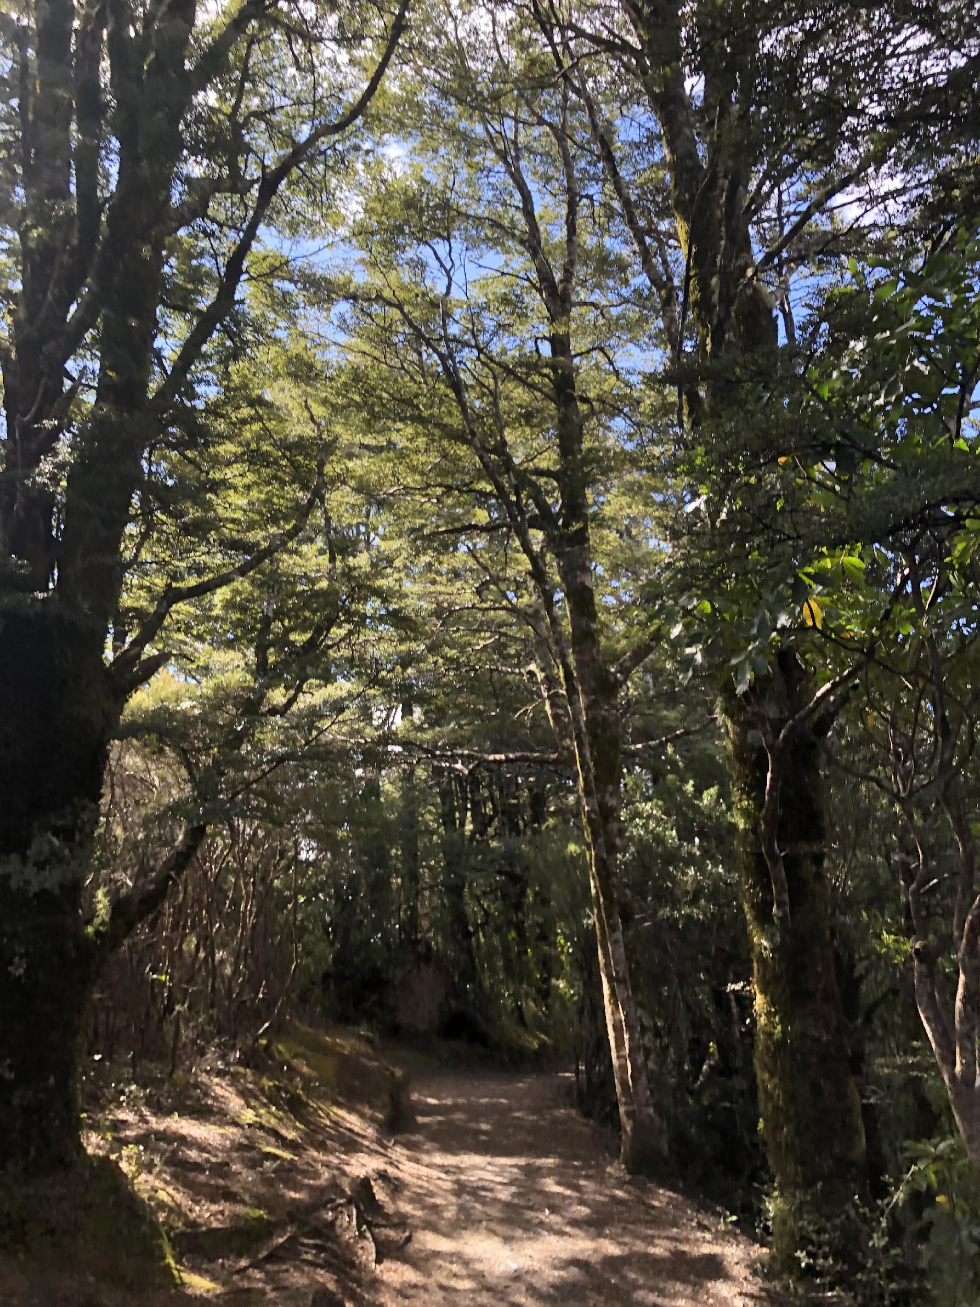
KIA WANA TE AKO
He Pūkōrero te Pūrākau
2021

Slide 3
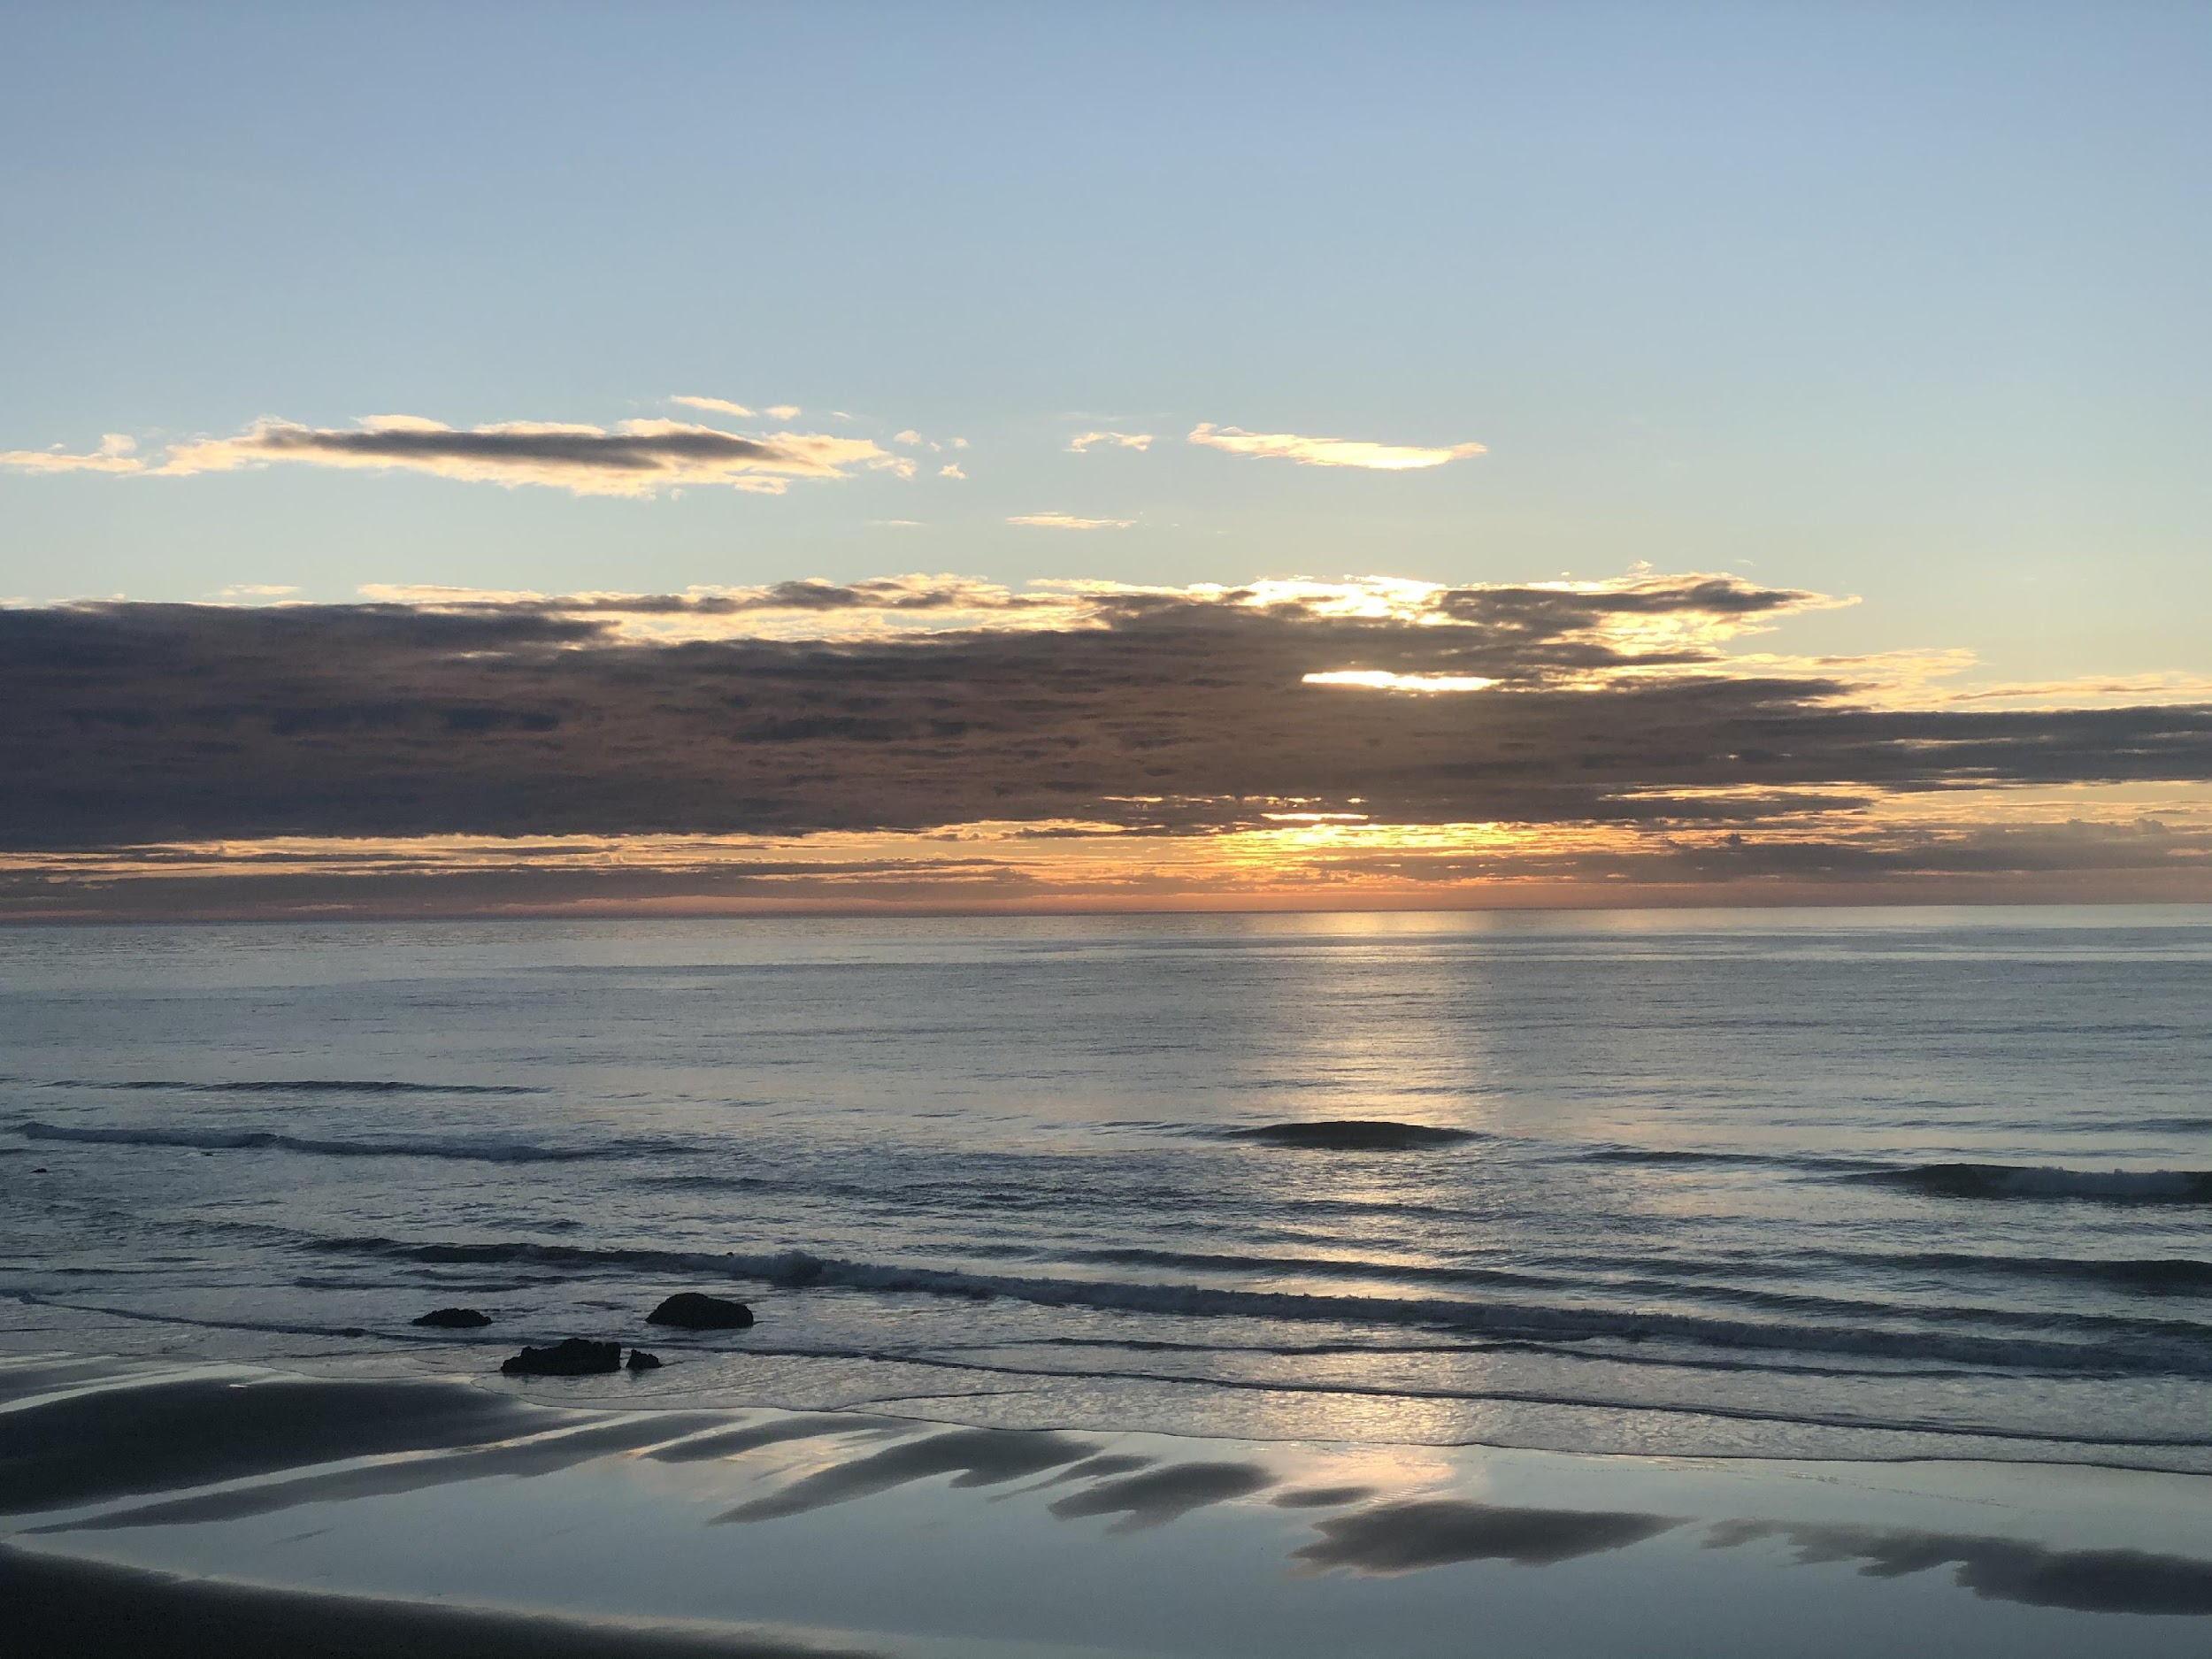
Ngā hua ka puta
Kia mārama ake ki te pūrākau hai huarahi ako i te reo ā-waha.
Kia rukuhia ētahi rautaki hai whakapakari ake i ngā pūkenga kōrero, whakarongo hoki.
Notes:
Setting the Scene | Outcomes for the day
To understand that ‘pūrākau’ is a context for the teaching and learning of oral language, specifically ‘whakarongo’ and ‘kōrero’
To examine strategies for developing listening and speaking skills

Slide 4

I takea mai a Reo ā-Waha i hea?
Where do you think ‘reo ā-waha’ originates from?
What is oral language?
Why is ‘whakarongo’ and ‘kōrero’ important
in learning how to read and write?
Notes:
Introductory discussion.
Consider these questions to find out prior knowledge about oral language:

Slide 5

E whakaako rānei i te reo ā-waha?
E puta ai te kōrero, me mōhio ki ngā momo take e kōrero ai tātau.
How do you teach reo ā-waha?
What strategies do you use?
For what purpose?
Notes:
Mahi ā-rōpū
Big paper/pens – brainstorm
How is reo ā-waha taught?
What is it taught through?

Slide 6
Notes:
Paramanawa

Slide 7

P Ū R Ā K A U
Ko te pūtake o te pūrākau whakamārama, he whakamārama i te takenga mai o ngā āhuatanga o te ao me te hua o aua āhuatanga ki te tangata.
He Manu Tuhituhi, Pūrākau Whakamārama
Notes:
Mahi ā-rōpū
What type of reo are identified in pūrākau – short discussion about the type of reo through this context
E.G Ngā tohu o te wā – indication of time, past tense ... i ngā wā o mua. (See next slide for other examples)

Slide 8

H E R E O P Ū R Ā K A U
Tohu i te wā.i R | Tērā he wao..., i onamata..., i neherā...
Reo take me te pānga | Nā te …i ..., nā runga i tērā…, ahakoa ...
Tūhono | Kātahi ka…, nā te mea, ā...
Whakaahua | Tīramarama mai ana, anō he porotiti, ngā makawe urukehu
Notes:
After brainstorm – discuss the reo examples and ask for more examples for each reo type

Slide 9
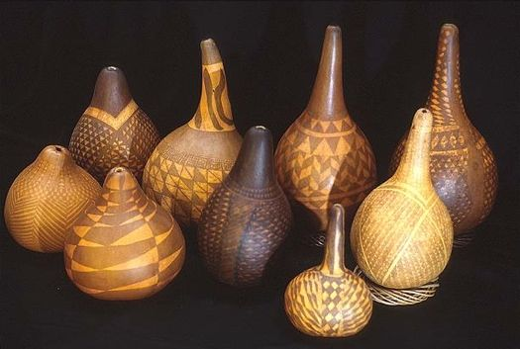
H I N E P Ū T E H U E
Notes:
Mahi Whakarongo
Read the pūrākau Hinepūtehue (He Pūrākau Whakamārama, He Manu Tuhituhi)
Listen for the types of reo discussed in the previous discussion
Tally up how many times they hear examples of reo (see tally in next slide)

Slide 10
W H A K A R O N G O M A I
Tūmomo reo | Tūtohi Tatau | Tapeke
Reo tohu i te wā (i te pūrākau) | ll | 2
Reo take me te pānga | lll | 3
Reo whakaahua | llll llll llll | 15
Reo tūhono | llll | 5
Notes:
Answers for the whakarongo activity - Hinepūtehue

Slide 11
Tohu i te wā | I te tīmatanga, i te mutunga
Reo take me te pānga | Nā te kōpapa o tā rātau noho, Ahakoa i wehea Nā tēnei mahi...
Tūhono | Inā hoki, Me (x2) Kātahi ka… ā
Whakaahua | Hamumu kōroiroi, roimata ua, kohu roimata, ka tipu ko te riri, ngā hau pūkeri, ngā hau mapu, ka rarā ngā rau o ngā rākau, ka pupuke ngā ngaru, ngā rākau riri, ka tioro ko ngā reo tangi, ngā hoihoi o ngā pakanga, te reo iti pūoro, reo pūoro reka, he hūmārie, he ngāwari
Notes:
Example sentences from pūrākau about Hinepūtehue – discuss if there are any other examples from the story.

Slide 12
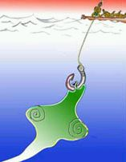
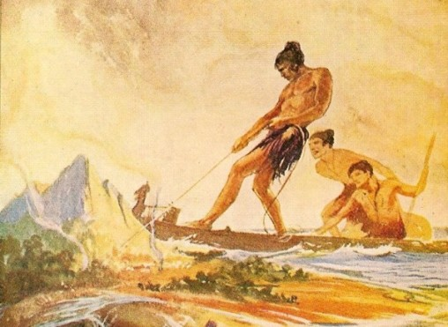
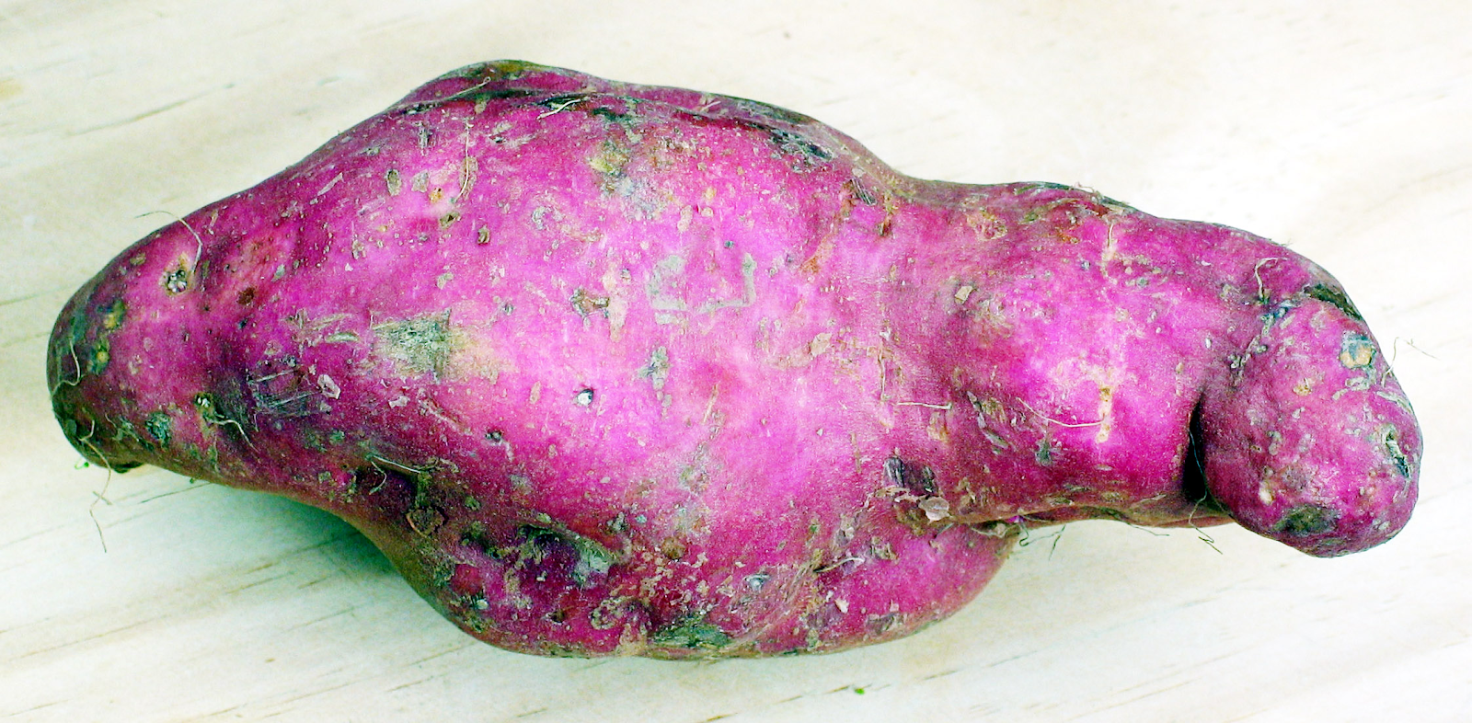
K I M I H I A T Ō H O A
Rongomātāne
Notes:
Kimiha tō hoa – create some cards for this activity
You will need a set of cards with the names (or pictures) of pairs E.G. Māui and Te Ika ā-Māui, Kūmara and Rongomātāne, Ranginui and Papatūānuku
Make sure you have enough for the number of people in the group
Each person needs to find their ‘hoa’ by asking questions or describing what is on their card.
They may NOT say who they are or show their card.
When each pair have found each other, get them to introduce themselves.

Slide 13
Notes:
Kai nui

Slide 14
K Ō R E R O | P Ā N U I
Oral Strip Story
He wāhanga tā ia tangata nō tētahi pūrākau
Ko tā ia tangata he pānui-ā-waha atu i tana wāhanga kia whakaraupapahia ngā rerenga kōrero kia tika te takoto
Ngā Ture:
Kaua e whakaatuhia tō kāri
Mā kōrero, mā whakarongo, mā pānui e oti ai te mahi.
Ko au te tuatahi
Notes:
Mahi ā-rōpū
Use a pūrākau to facilitate this activity
Make sure you either create the strips to teach grammar OR to teach text meaning.
If you want to teach meaning – make sure your strips are cut into full sentences.
If you want to teach grammar – strips will be cut in between sentences E.G.Strip 1: I ngā wā o mua, tērā tētahi Strip 2: manu. He manu nui, he manu hianga, he manu Strip 3: matekai.
Keep text on each strip short – each person read their strip to themselves then read aloud so the rest of their group hear the text.
The group then starts deciding which text is first, second and so on, in order to re-sequence the story correctly.

Slide 15
T Ū H O N O H O N O
Nā tēnei mahi ...
A sweet sound ...
He reo reka …
As a result ...
Notes:
Mahi takirua
Using a pūrākau, select a few of the phrases from the story
Create cards with these written on them and another set for the English equivalent
Working in pairs, match the Māori phrase to the English

Slide 16
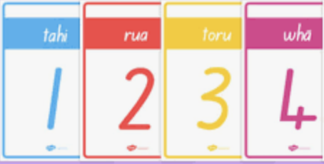
W H A K A R A U P A P A T A N G A
Mahi takirua
Work together to put the pūrākau
back in the correct order.
Read each paragraph carefully
before starting.
Notes:
Pānui | Kōrero – making meaning.
Using the same pūrākau as above, cut into paragraphs
Working in pairs, read the strips to make meaning of the whole story
Put each strip (paragraph) back into sequential order to create the story again

Slide 18
Reo tohu i te wā | Reo take me te pānga | Reo whakaahua | Reo tūhono
I ngā wā o mua I ngā rā o mua | Nā te … Nō reira.. | Tino haututū… Te tino ātaahua … | Kātahi ka ā, ka…
Notes:
Recap
Look at the table together
Ask if there are any other examples for each column that can be added
Add these to the chart

Slide 19


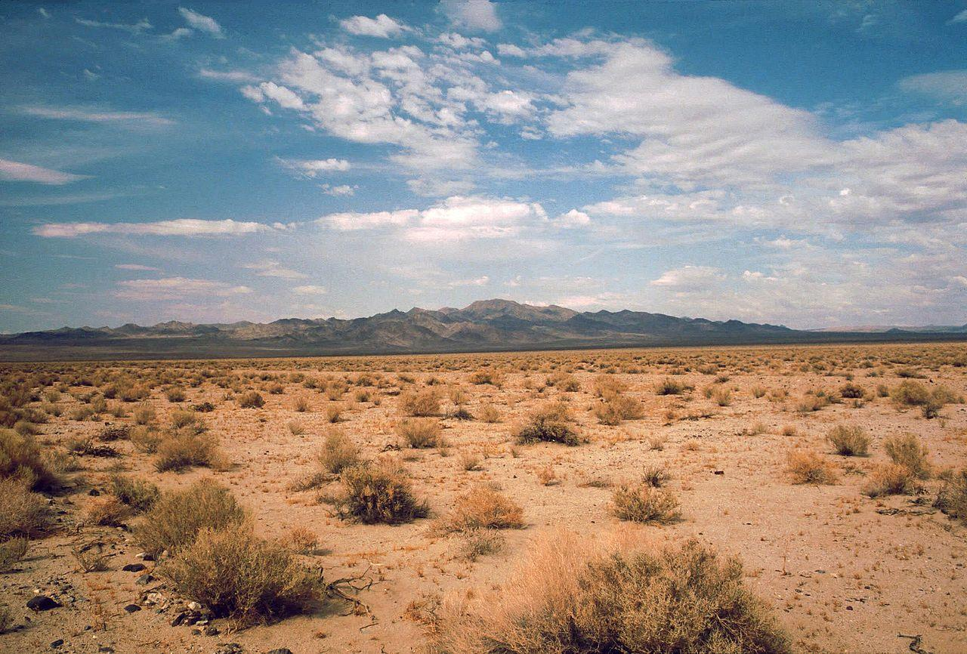
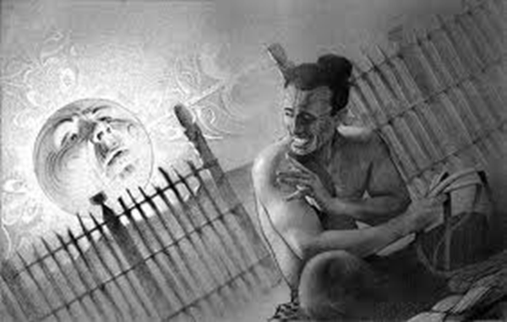
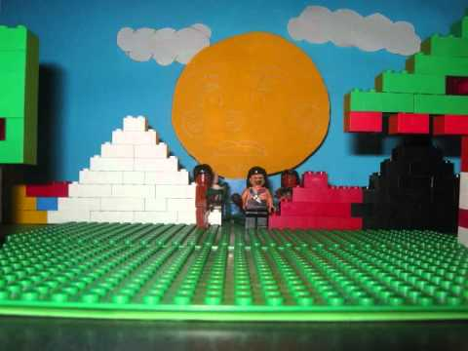
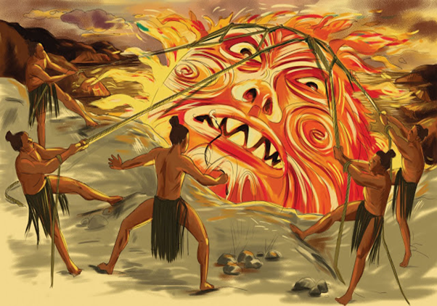
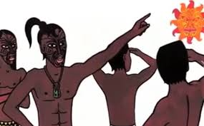
W A I H A N G A K Ō R E R O
200KM
Notes:
Mahi ā-rōpū
This is a well-known pūrākau
Using the picture cards, and following the arrows, the group works together to orally present the pūrākau
N.B It is important the groups use the reo examples specific to pūrākau to recreate the story.
Variation – groups use the pictures, and their knowledge of the pūrākau, to create a more modern take on this traditional narrative.

Slide 20


W H A K A A T U R A N G A
LIGHTS, CAMERA, ACTION!
Prepare a presentation of your pūrākau
Add imagery, action, animation
Create ‘voice’, music, dynamics
Notes:
Mahi ā-rōpū
Working in the same rōpū, prepare a presentation of the modern-day version of the pūrākau they created
Encourage using visuals, audio, video, whakaari, voices for characters etc.
Encourage using digital technology, apps etc
After 30mins, each group stands to present to the whole rōpū.

